Slide 2
Acceptability of HIV and syphilis domiciliary testing among transgender women in Buenos Aires, Argentina
Virginia Zalazar, C. Frola, A. Gun, N. Cardozo, M. Duarte, S. Fabian, P. Radusky, I. Aristegui, P. Cahn, O. Sued.
@FundHuesped
Share your thoughts on this presentation with #IAS2019

Slide 3
No conflict of interest
Acknowledgements

Slide 4
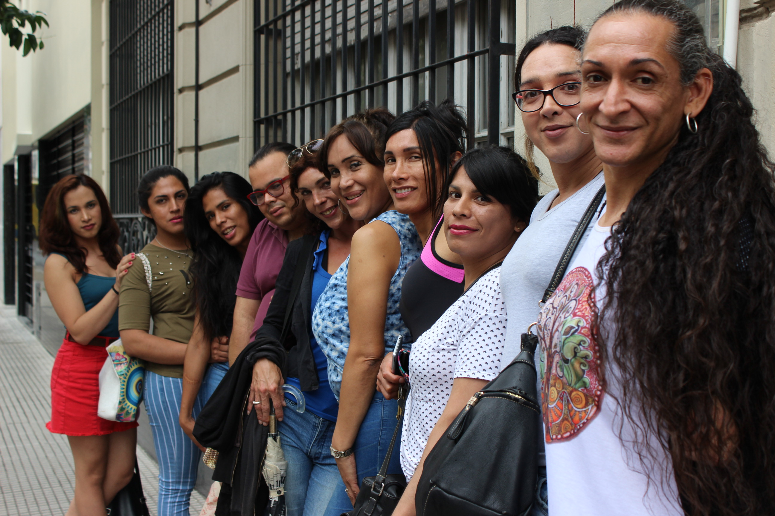
Transgender women in Argentina
MOST AFFECTED KEY POPULATION
Extremely low life expectancy (estimated 35 years)
Discrimination, isolation and lack of support
High prevalence of infectious diseases
HIV prevalence: 34%
Syphilis: 50.4%
HPV: 97%
HCV: 4.5%
Carobene M, Bolcic F, Farı ́as MSDR, et al. HIV, HBV, and HCV molecular epidemiology among trans (transvestites, transsexuals, and transgender) sex workers in Argentina. J Med Virol. 2014;86:64–70.

Slide 5
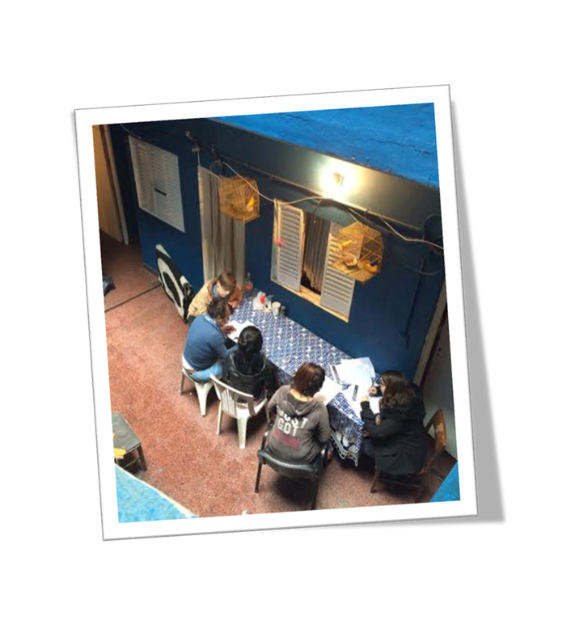
National survey
498 respondents (452 TGW & 46 TGM)
41% of TGW avoided seeking healthcare
Factors associated were:
Discrimination by healthcare workers (aOR = 3.36)
Discrimination by other patients (aOR = 2.57)
Currently living in Buenos Aires metropolitan area (aOR = 2.32)
Been exposed to police violence (aOR = 2.20)
Internalized stigma (aOR = 1.60)

Slide 6
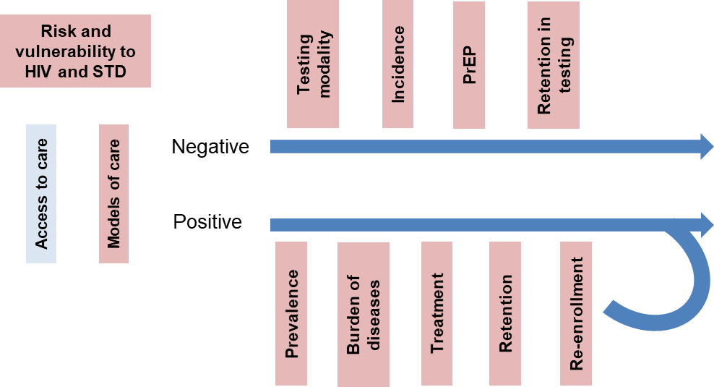
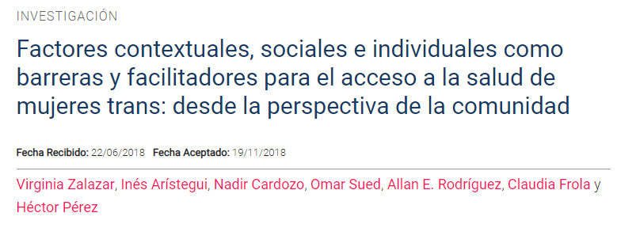
TransHoteles: preferred models of healthcare services
Qualitative study to evaluate potential interventions to improve HIV outcomes among TGW
Need to provide trasn-sensitive care
Domiciliary prevention and testing
Multdisciplinary team
Facilitated appointments.
Peer navigators on HIV services

Slide 7
Domiciliary provider-initiated testing strategy
Argentine organization with regional scope with focus HIV/AIDS and sexual and reproductive health.
Argentina’s Association for Travesti, Transexual, and Transgender rights and Regional Secretariat of the Latin American and Caribbean Transgender Network.
Organization of transgender women that self-manage a squat, a crucial refuge for transgender women in Buenos Aires.

Slide 8
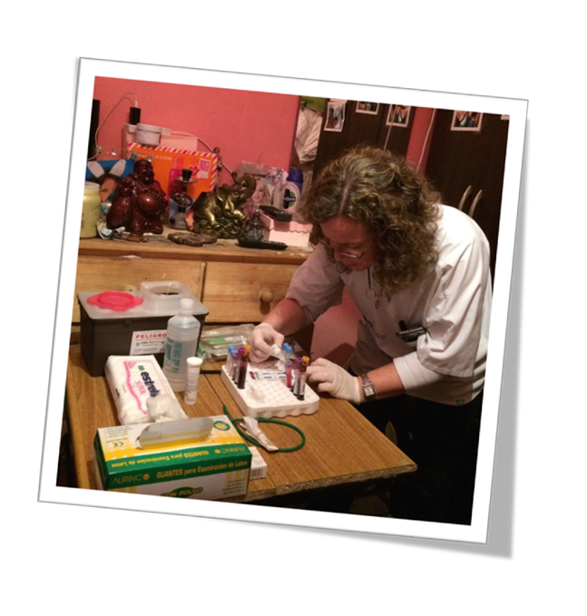
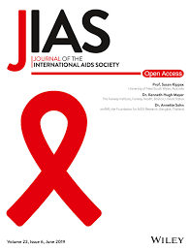
TransTesting: HIV diagnosis
From November 2015 to August 2017, 260 TGW were tested for HIV in 4 cities of Argentina.
Two rapid tests were compared (HIV-1/2 antibodies vs. HIV-1/2 antibodies and HIV-1 p24 antigen)
51 TGW were HIV positive by RT and ELISA (19.6%), 2 additional women identified through NAT (Viral Load Pool)
HIV + Associated factors
Previous STIs (aOR= 3.29, 95% CI 1.48-7.32)
Not having been tested before (aOR= 4.20, 95% CI 1.76-10.01)
(Submitted to JIAS)

Slide 9
Trans-ITS: HIV and syphilis rapid test
Inclusion criteria self-identified as TGW; ≥14 years old; previous HIV-negative >3 months or unknown status; non-history of syphilis or previous episode with >6 months after treatment.
Acceptability survey included 5 items with a 5 point-Likert scale, a satisfaction question, and comments.
SD BIOLINE HIV/Syphilis Duo rapid tests was used (detects antibodies to HIV-1 including subtype-O, HIV-2 and Treponema pallidum).
HIV infection was confirmed by VL. Positive treponemal tests were complemented with quantitative RPR to identify active syphilis or past infection. All confirmed cases were referred for treatment initiation and follow-up.

Slide 10
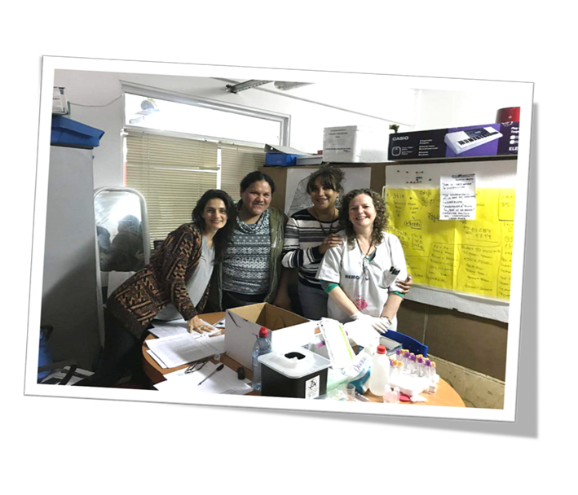
Results
From May 2018 to December 2018, 68 TGW were tested in the metropolitan area of Buenos Aires
Median age: 26 (IQR: 25.7–29.8)
Most of them were sex workers (77.9%)
HIV prevalence was 4.4%
50% had syphilis antibodies (26.5% indicating incident syphilis and 23.5% showing adequate response to previous treatment)

Slide 11
Acceptability survey
98.5% considered the domiciliary rapid test as a very good/good strategy.

Slide 12
Conclusions
TGW have a high prevalence of syphilis and HIV.
Research activities constitute a fundamental input to inform evidence-based policies on the feasibility and acceptability of new strategies for the diagnosis of STIs that contributes to the development of appropriate and effective interventions to promote access to health services
Domiciliary provider-initiated rapid testing of STIs is a feasible, acceptable and a successful approach for this hard-to reach population.

Slide 13
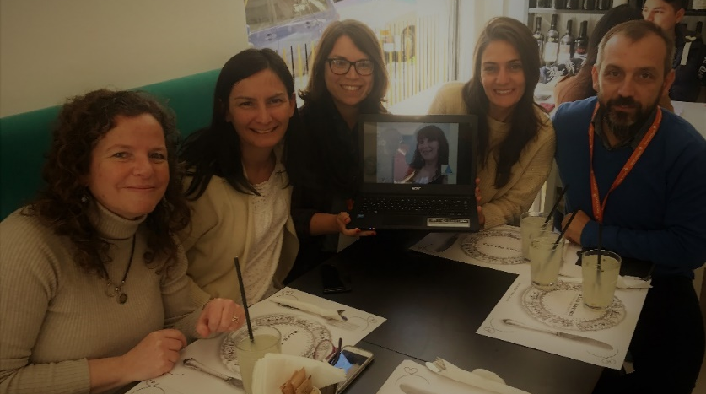
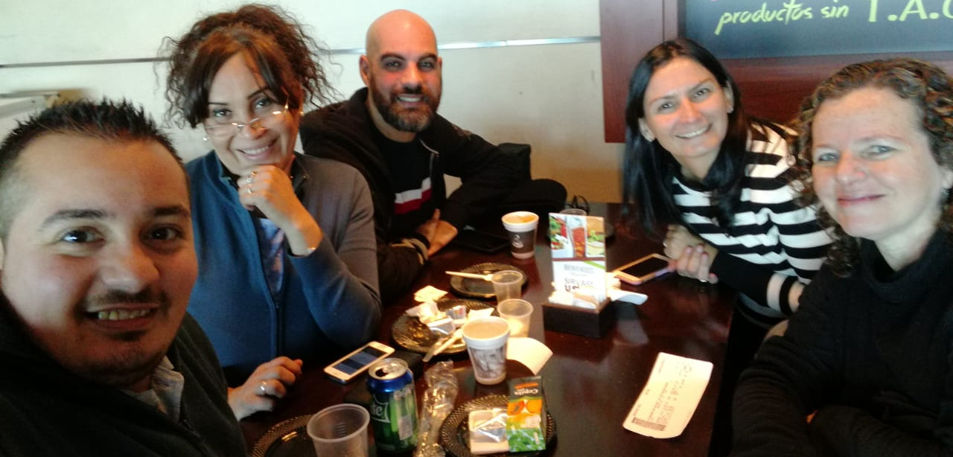
Acknowledgments
to the TGW representatives of the venues where the tests were performed and to all the participants of this study.
Abbot provided SD BIOLINE HIV/Syphilis Duo rapid test

Slide 14
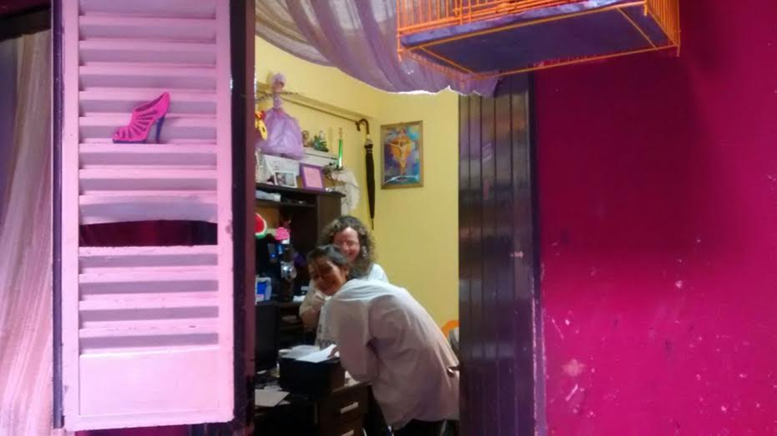
¡Gracias!
Corresponding author: virginia.zalazar@huesped.org.ar

